Slide 1


Department of ICT
A project(1/minor/major)/proposal/mid-term/final defense on:
“Optical Character Recognition”
Project Members:
Abhishek Joshi 200302
Prashant Phuyal 200324
Prashant Shrestha 200325
Saurav Karki 200334
Submitted to:
Department of ICT
Cosmos College of Management and Technology
Date : 19th May, 2024

Slide 2
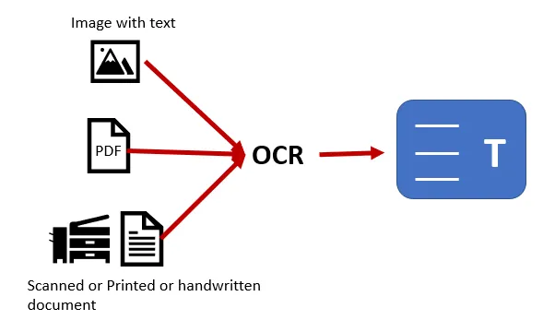
INTRODUCTION
OCR (Optical Character Recognition)
is a technology used to convert
different types of documents, such
as scanned paper documents, PDFs,
or images captured by a digital
camera, into editable and
searchable data.

Slide 3
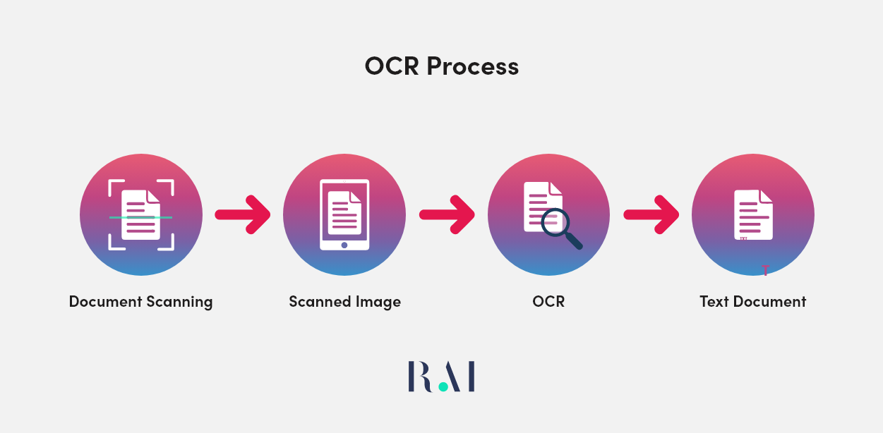
How Optical Character Recognition works
Pre-processing
Character Recognition
Post-processing

Slide 4
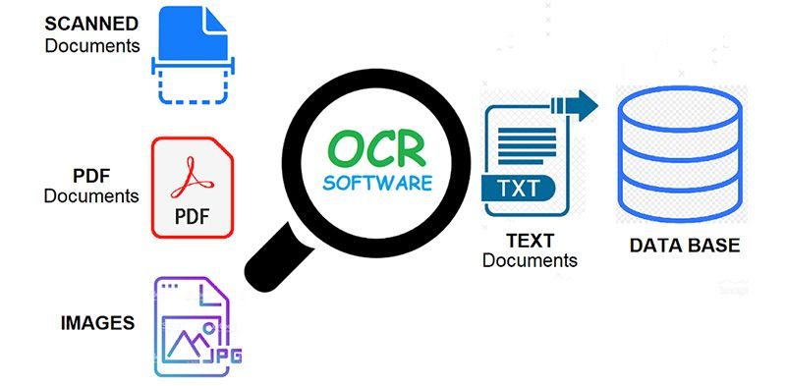
Application
Reduces manual data entry errors.
Organizes and retrieves documents.
Automates form processing.
Digitizes historical documents.

Slide 5
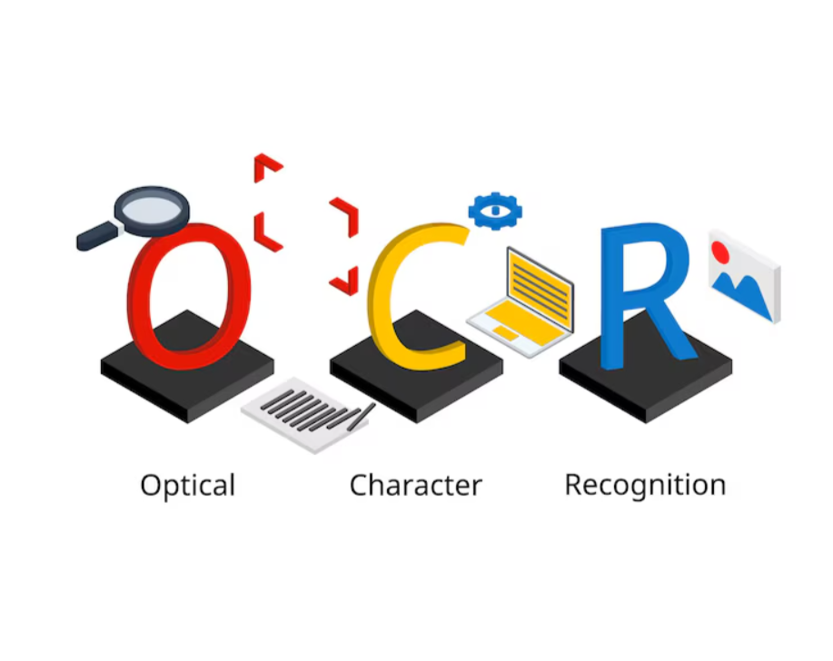
Objective
To develop a robust and efficient Handwritten OCR system capable of accurately recognizing and converting handwritten text into machine-encoded text.

Slide 6
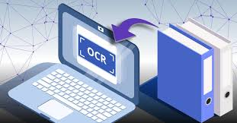
Tools and Equipment
Hardware = laptop with Intel processor i5 or more.
Software::
Frontend= Dart, Flutter
Backend=Python
Documentation=Ms-Office
IDE=Microsoft Visual Studio

Slide 7
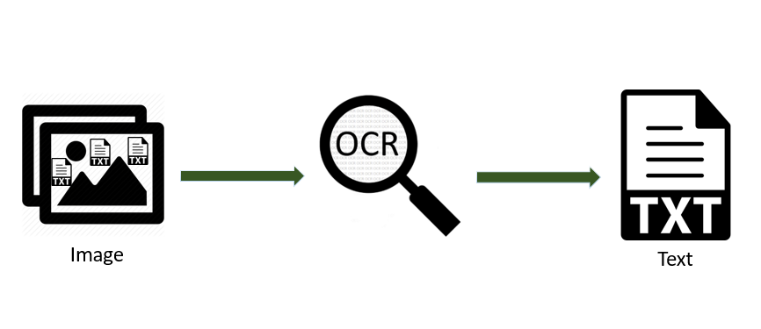
Methodology in OCR
Requirement gathering
System design
Logical design
Software process model

Slide 8
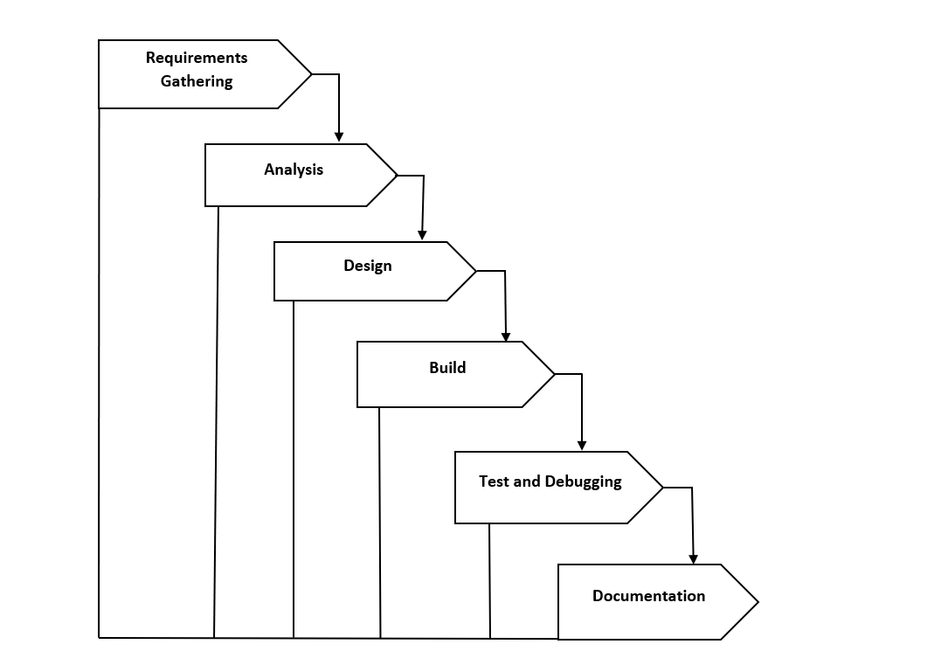
Waterfall model

Slide 9
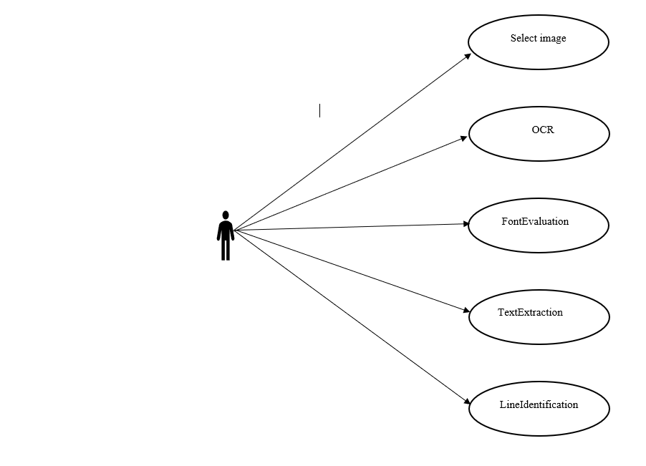
Use case diagram

Slide 10

Expected Outcomes
Accurate Text Recognition
Increased Efficiency
Editable Documents
Reduced Errors
Time Savings

Slide 11

Time Period
Planning
Analyzing
Design and coding
Testing
Implementation
Maintenance

Slide 12

Future Enhancements
Real-time OCR
Improved Accuracy
Multilingual Support
Better Noise Handling

Slide 13
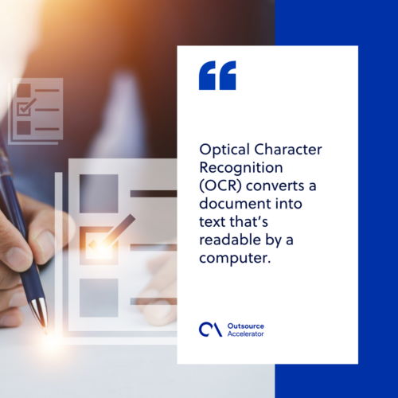
Conclusion
Successful Text Conversion
Improved Efficiency
Enhanced Accessibility
Potential for Expansion

Slide 14
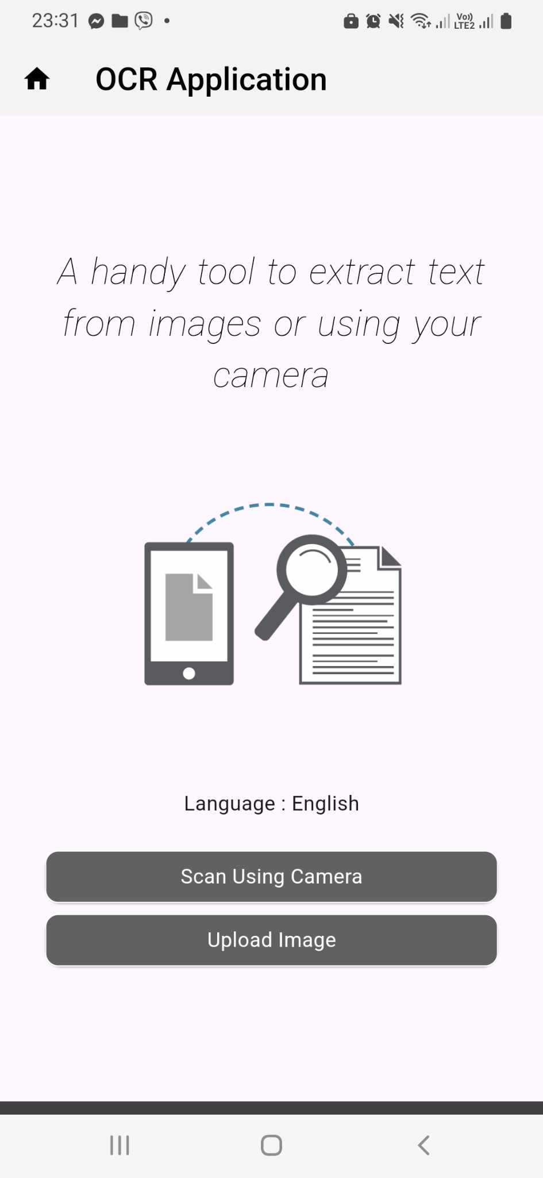
Snapshot

Slide 15
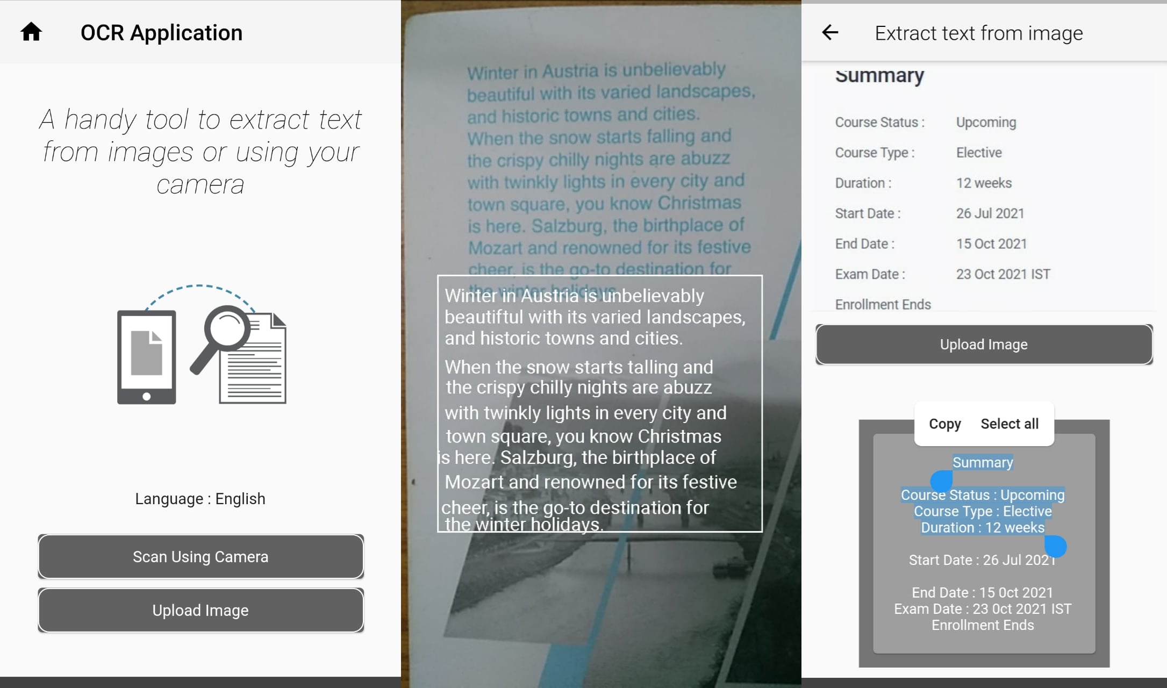
Snapshot

Slide 16
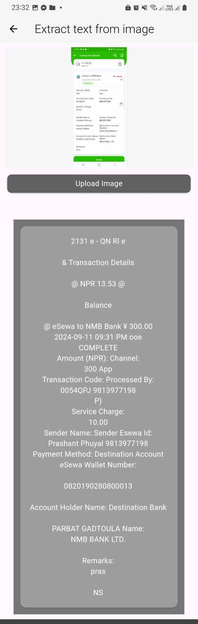
Snapshot

Slide 17
Thank You!

